Slide 1
Particle System Soft Body Simulation
TA: 劉彥廷
2018/03/29

Slide 2
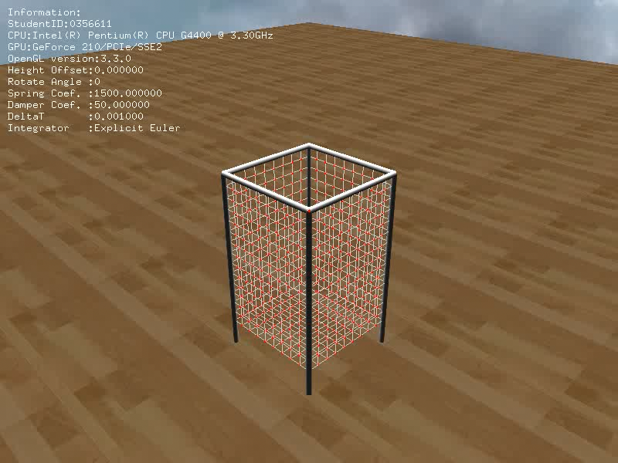
Demo

Slide 3
Objective
Simulate soft body by mass-spring system
Initialize the mass-spring system
Compute spring and damper forces
Handle collision
Integrate
Generate video

Slide 4
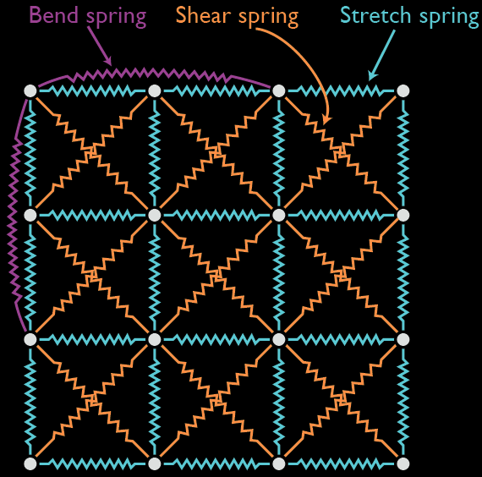
Mass-Spring System
A set of particles are connected by springs
A simple approach to simulate solid deformable objects

Slide 5
System Overview
OS: Windows
IDE: Visual Studio 2013
Lib
Mass-Spring System
OpenGL
GoalNet
Ball
glut
Particle
Spring
glui
Bmp
Vector

Slide 6

Note
Remember to modify you Student Id in the “Configuration.txt”

Slide 7
Algorithm Overview
Initialization
Simulation
Render

Slide 8
What You Should Do
Initialization
Simulation
Render

Slide 9
Initialization
Initialization
Connect particles by springs
Simulation
Render

Slide 10
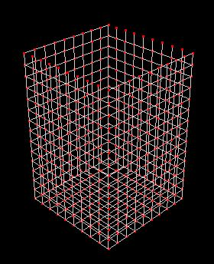
Structural Spring
Establish the basic structure of the net
Connect every particle to its direct 5 neighbors

Slide 11
Simulation
Initialization
1. Compute spring and damper force
Simulation
2. Handle collision
Render
3. Explicit Euler Integration

Slide 12
Spring and Damper Forces
Review “particle.ppt” from p.9-p.13

Slide 13
Point-Plane Collision
Review “particle.ppt” from p.14-p.19
The default plane is y=-1
Recommend ε is 0.01
Coefficient of restitution
Coefficient of friction

Slide 14
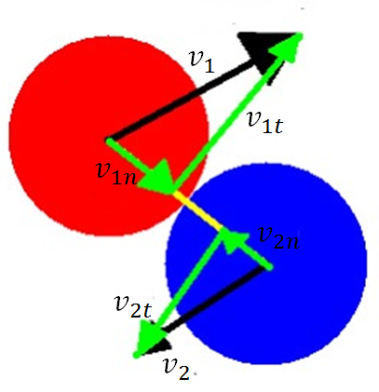

Sphere-sphere collision
handle ball-ball collision and ball-particle collision
$$v_{1}^{′}=\frac{v_{1n}\left(m_{1}−m_{2}\right)+2m_{2}v_{2n}}{m_{1}+m_{2}}+v_{1t}$$
$$v_{2}^{′}=\frac{v_{2n}\left(m_{2}−m_{1}\right)+2m_{1}v_{1n}}{m_{1}+m_{2}}+v_{2t}$$

Slide 15
Explicit Euler Integration
Review “ODE_basic.ppt” from p.15-p.16
The default △t is 0.001

Slide 16
Runge Kutta 4th(RK4) integration
Review “ODE_basic.ppt” from p.21
Or “Physically Based Modeling” from p.B5-p.B6

Slide 17
What You Should Know
Coordinate
Class “Vector3d”
Class “CParticle”
Class “CSpring”
Class “GoalNet”
Class “Ball”
Class “CMassSpringSystem”
GUI
Configuration file
Output video

Slide 18
Coordinate
y
x
z

Slide 19
Class “Vector3d”
Provide basic vector operators and methods
+, -, *, / , DotProduct, CrossProduct, Length, Normalize
“Length()” returns the length of the vector
Operator “*” is neither dot nor cross product

Slide 20
Class “Vector3d” (con’t)
“Normalize()” normalizes itself and returns the length of the original vector
“NormalizedCopy()” returns its normalized vector
Reference “Vector3d.h” in the directory “Math” for details

Slide 21
Class “CParticle”
Important member variables
double m_dMass;
Vector3d m_Position;
Vector3d m_Velocity;
Vector3d m_Force;

Slide 22
Class “CParticle” (con’t)
No acceleration
Set and Get acceleration will modify “m_Force”
Reference “CParticle.h” in the directory “MassSpringSystem” for details

Slide 23
Class “CSpring”
Important member variables
int m_iSpringStartID;
int m_iSpringEndID;
double m_dRestLength;
double m_dSpringCoef;
double m_dDamperCoef;
enType_t m_nType;

Slide 24
Class “CSpring” (con’t)
Constructor
CSpring(const int a_ciSpringStartID,
const int a_ciSpringEndID,
const double a_cdRestLength,
const double a_cdSpringCoef,
const double a_cdDamperCoef,
const Vector3d &a_rcColor,
const enType_t a_cType);

Slide 25
Class “CSpring” (con’t)
“a_ciSpringStartID” and “a_ciSpringEndID” are the index in the 1D array which stores particles

Slide 26
Class “GoalNet”
Important member variables
vector<CParticle> m_Particles;
vector<CSpring> m_Springs;
int m_NumAtWidth;
int m_NumAtHeight;
int m_NumAtLength;

Slide 27
Class “GoalNet” (Con’t)
The “vector” is an STL container, it is not the “Vector3d”.
“m_Springs” is not initialized, you should construct springs in correct way as mentioned previously.

Slide 28

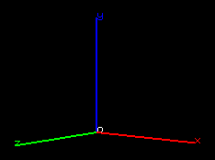
Class “GoalNet” (con’t)
For simplicity, you can think of an goal net as a cuboid
length
height
width

Slide 29
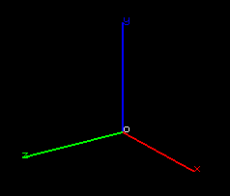





Class “GoalNet” (con’t)
Use ‘GetParticleID’ to transform index between 1D and 3D array
$n_{w}$ : number of particles at width
$n_{h}$ : number of particles at width
$n_{l}$ : number of particles at length
$$(0,n_{h}−1,0)$$
$$(0,0,n_{l}−1)$$
$$(0,0,0)$$
$$(n_{w}−1,0,0)$$

Slide 30
Class “GoalNet” (Con’t)
Finish the following methods:
Search “TO DO”
InitializeSpring()
ComputeInternalForce()
ComputeSpringForce()
ComputeDamperForce()

Slide 31
Class “Ball”
similar to ‘particle’
double m_dMass;
double m_dRadius;
Vector3d m_Position;
Vector3d m_Velocity;
Vector3d m_Force;

Slide 32
Class “CMassSpringSystem”
Important member variables
int m_iIntegratorType;
double m_dDeltaT;
GoalNet m_GoalNet;
vector<Ball> m_Balls;

Slide 33
Class “CMassSpringSystem” (Con’t)
Finish the following methods:
Search “TO DO”
ParticlePlaneCollision
BallPlaneCollision
BallToBallCollision
BallParticleCollsion
ExplicitEuler
RungeKutta

Slide 34
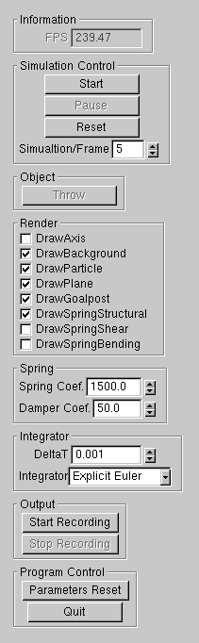
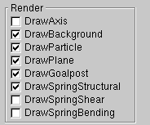

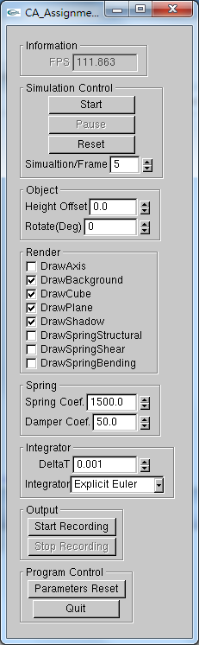
GUI

Slide 35
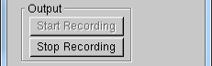
Output Video
“Start Recording”
output a serial of images after clicking “Start” button
“Stop Recording”
Stop recording and then output video

Slide 36
Output Video (con’t)
After few seconds, you will get a video in the directory “ParticleSystem”
Be careful of the new video will replace the old video if their filenames are same

Slide 37
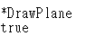
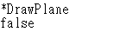
Configuration File
All important parameters are in the “Configuration.txt”
You can modify some of parameters to get different initialization
For example,
In this case, plane will not be showed in the beginning

Slide 38
Recommended approach
Implement intergrator
Explicit Euler (or Runge Kutta)
Construct the spring
Draw the connected spring to confirm the constrained relations
Calculate internal force of goal net
compute spring force and damper force
Detect/resolve the collision

Slide 39
Grading
Construct the connection of springs 10%
Compute spring and damper forces 20%
Handle collision 30%
particle-plane collision 5%
ball-plane collision 5%
ball-particle collision 10%
Ball-ball collision 10%
Explicit Euler integration 5%
Runge Kutta 4th integration 20%
Report: 20%
Bonus 15%

Slide 40
Bonus
Material of the net
Rotating ball
Any other fun (describe them in your report)

Slide 41
Suggested Outline of Report
1. Introduction/Motivation
2. Fundamentals
3. Implementation
4. Result and Discussion
the difference between Explicit Euler and RK4
effect of parameters
5. Conclusion

Slide 42
Submission
Compress all the materials into a zip file
– Naming rule: CA1_StudentID_Version,
e.g., CA1_0356611_v001.zip
Your zip file shall contain
– Source code (ensure your project build successfully)
– 2 videos(include Euler and Runge Kutta)
– Report in pdf or MS word format, no more than 10 pages
Upload all your materials to E3
– No limit to the no. of times of upload
– The latest version is your final submission

Slide 43
Late and Cheating
Late policies
Penalty of 10 points of the value of the assignment/day
Cheating policies
0 points for any cheating on assignments
Allowing another student to examine your code is also considered as cheating

Slide 44
Deadline
Deadline
Thursday ,2018/04/12 ,23:59

Slide 45
You can find TA in…
Email:
liou8308@gmail.com
Lab EC229B
Need appointment
Please briefly mention your question when you contact me

Slide 46
Reference
Slides on E3
Real Time Physics (Siggraph 2008 class)
http://www.matthiasmueller.info/realtimephysics/index.html

Slide 47
Q&A

